Slide 1
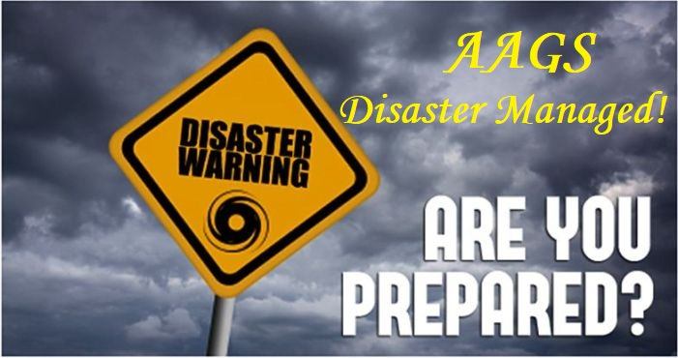

Slide 2
$154 billion
75,000
Countless
were lost due to natural disasters last year
beautiful lives were lost
lives were ruined
Notes:
People connected to victims also get ruined.

Slide 3
Most Vulnerable Countries:

Slide 4

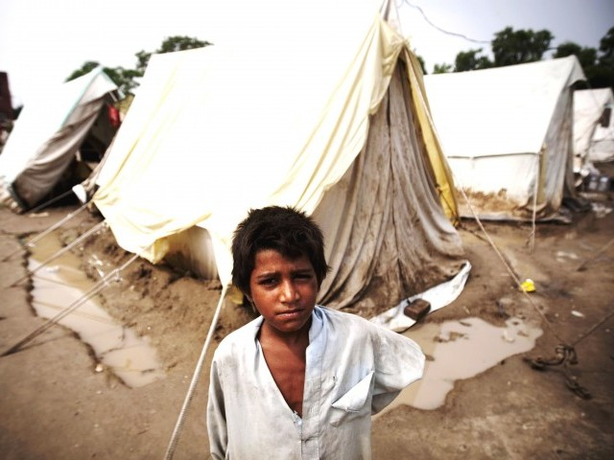
A PICTURE WORTH A THOUSAND WORDS
Notes:
Personally lived and volunteered through a Flood so I know how it feels.

Slide 5
Our Features:
Safety Check
Internetless Chat
Making sure your loved ones know you’re safe is something very important during calamities. Their tension can be reduced using this feature.
When network towers break down or don’t work, this feature is something which will definitely work.
1
3
Drones To 3D Map The Location And Find Number Of Victims.
Finding out where victims are stuck turns out to be useful while sending help. This is why we decided to incorporate this feature.
2
Notes:
It’s important to help people be prepared for disasters, be able to cope up during them and also get back to normal after it ends. Our product helps the victim in all 3 of the above mentioned ways.

Slide 6
Our Features:
Predicting Earthquakes
Precautionary Software
Connected to Already Existing
Softwares
In earthquake prone countries like Indonesia, Turkey and Mexico it is essential to know when the next catastrophe will take place. We help them be prepared.
It is important to predict disasters in order to come up with appropriate measures to save as much property and life as possible.
4
6
Fundraising Option
Money as well as food: two things every victim needs to come out of the trauma and restore their lives back to normal.
5

Slide 7
Our Features:
Live Ground Status
Drones To Deliver Amenities.
Knowing the status of what is happening on the ground can help us predict which is the next safest spot everyone can reach to.
Human help can’t be provided at all geographic locations and hence we have drones to do just that.
7
9
Cloud Formation Reader
Cyclones are a big threat to lives in coastal areas. Through this feature, we intend to predict cyclones too.
8

Slide 8
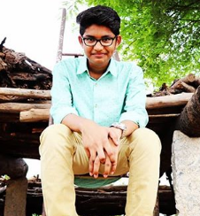
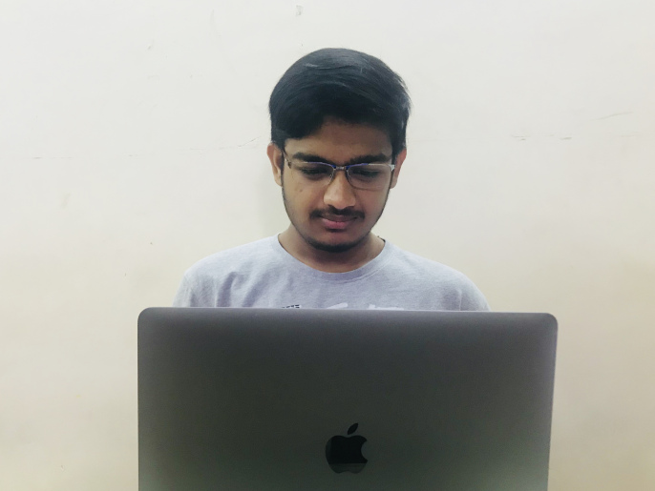

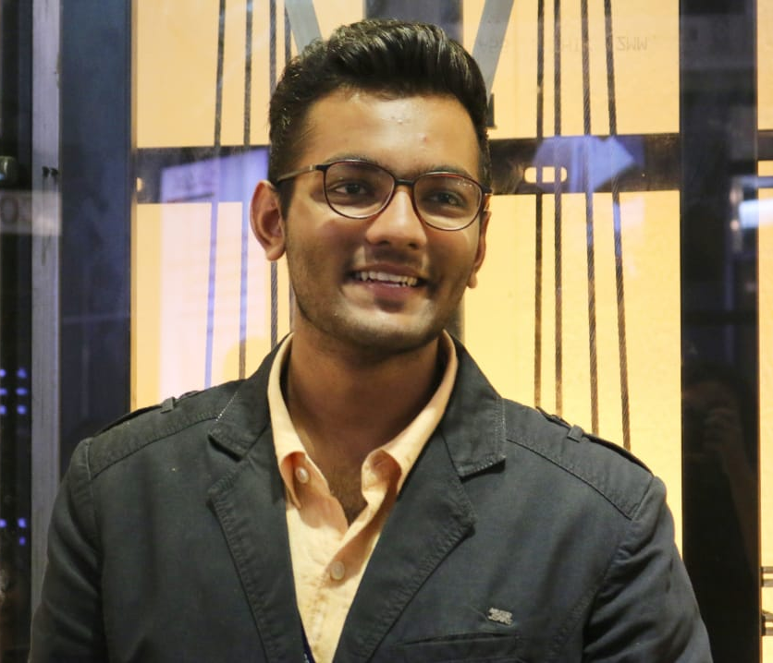
The Team
Akshat Gupta
Sai Sandeep
Gauransh Arora
Arth Chowdhary

Slide 9
THANKS!
Any questions?
Company Name: AAGS
Product Name: Disaster Managed!
Email: aags.disastermanaged@gmail.com
Phone: +919600093179
Location: Vellore Institute of Technology, Vellore- 632014. Tamil Nadu, India.

